Slide 1
Links this week: Twitter people
I follow many more, but these are a few of my favorites:
https://twitter.com/EdwardTufte - Edward Tufte
https://twitter.com/flowingdata - Nathan Yau
https://twitter.com/jschwabish - Jon Schwabish
https://twitter.com/DashingD3js - D3 visualization
https://twitter.com/visualisingdata - Andy Kirk
https://twitter.com/hadleywickham - Hadley Wickham (R Wizard)

Slide 2
Homework Last Week
Glenn called me out on the missing data.
Kiyoshi's map - Creative, got me thinking about something to build on?
Jenny – great presentation of data, lots of context.
https://public.tableau.com/profile/jenny.richards#!/vizhome/CampaignContributionMadness/Dashboard2
Carson's static images
Amelia's layout
https://public.tableau.com/shared/9GSXX7YC7?:display_count=yes
Eloisa - great summary and data presentation.
https://public.tableau.com/profile/eloisa.raynault#!/vizhome/WashingtonStatesContributionstoPoliticalCandidates/WashingtonStatesContributionstoPoliticalCandidates
Legends, legends
Mean, count, count distinct
Careful when presenting too many values or dimensions

Slide 3

Relational Data & Data Modeling: Joining things together
Week 6
Feb 16, 2016

Slide 4
Today’s Topics
Modelling data with Lucidchart
Joining data in Tableau
Joining data with SQL
Geospatial “Joining”

Slide 5
What is a data model?
A data model describes the data entities and relationships in a database.
A data model helps you understand:
What are the tables, columns, and relationships?
What are the collections, fields, and connections?

Slide 6
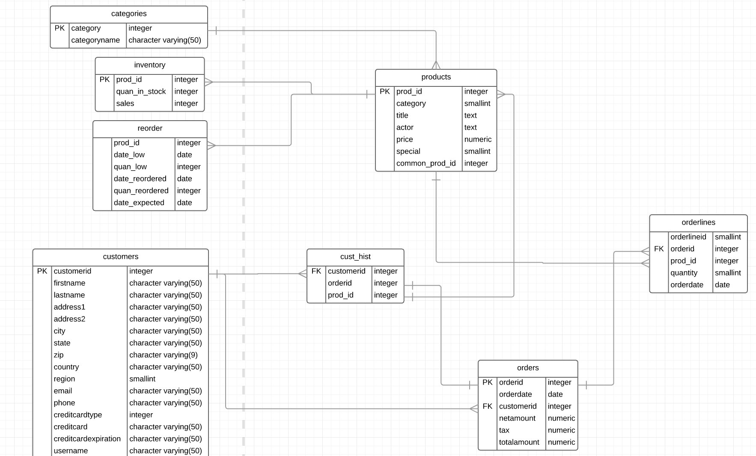
Model a Database in Lucidchart: DVD Store
“dell_store” dvd store database http://linux.dell.com/dvdstore/
Decent relational database, with same fake data
Eight total tables, with various relationships
Similar to what might be found in a production database
Side note: Most companies have hundreds of tables in their databases

Slide 7
First, schema definitions
“CREATE” for three “TABLES”:
dell_store.products, dell_store.orderlines, dell_store.categories
These SQL statements:
Define the data including: name, position, data type, and more
Resemble Excel headers with much more power
Are used to build Entity Relationship Diagrams (ERD)
Are a way to familiarize yourself with your company’s data.

Slide 8
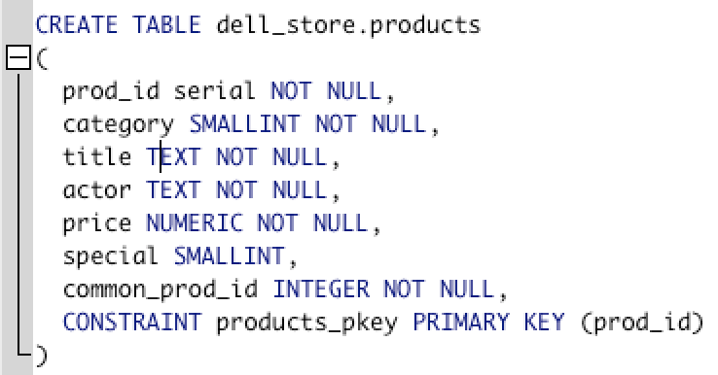
Schema for Products
Table name: dell_store.products
What we can learn:
Products have a “prod_id” which is a unique identifier (the “Primary key”
Products have a title
Products have a category (wonder why it’s just a “SMALLINT”)
Products have a price

Slide 9
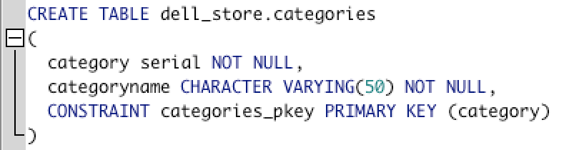
Schema for categories
Table name: dell_store.categories
What we can learn:
Has a key named “category” which is serially generated by database
Has a category name

Slide 10
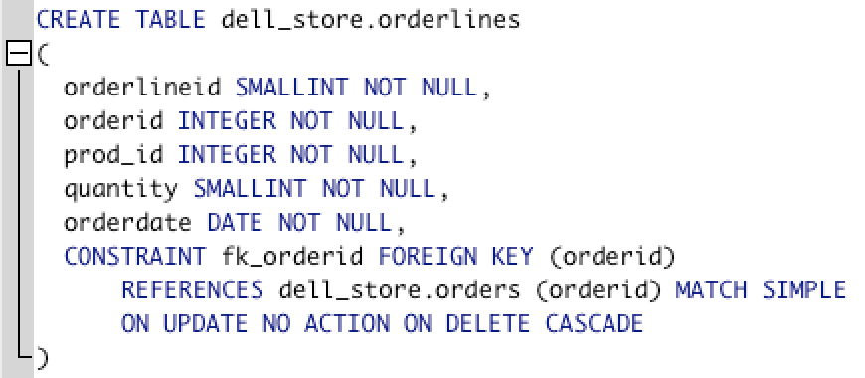
Schema for orderlines
Table name: dell_store.orderlines
What we can learn:
An order line must belong to an order
An order line has a prod_id (join to the products table)
Has an orderdate. Seems redundant with orders
No price. That means there’s no record of line-item pricing

Slide 11
The Entity Relationship Diagram (ERD) for the DVD Store
In Lucidchart web UI
Create new blank “ERD” chart
In Entity Relationship menu, click Import
Copy and paste SQL from Lucidchart into SQL tool
Paste results from SQL back into Lucidchart (this is yet another way of viewing a schema)
Build the diagram with drag-and-drop
Add relationships if they weren’t explicit

Slide 12
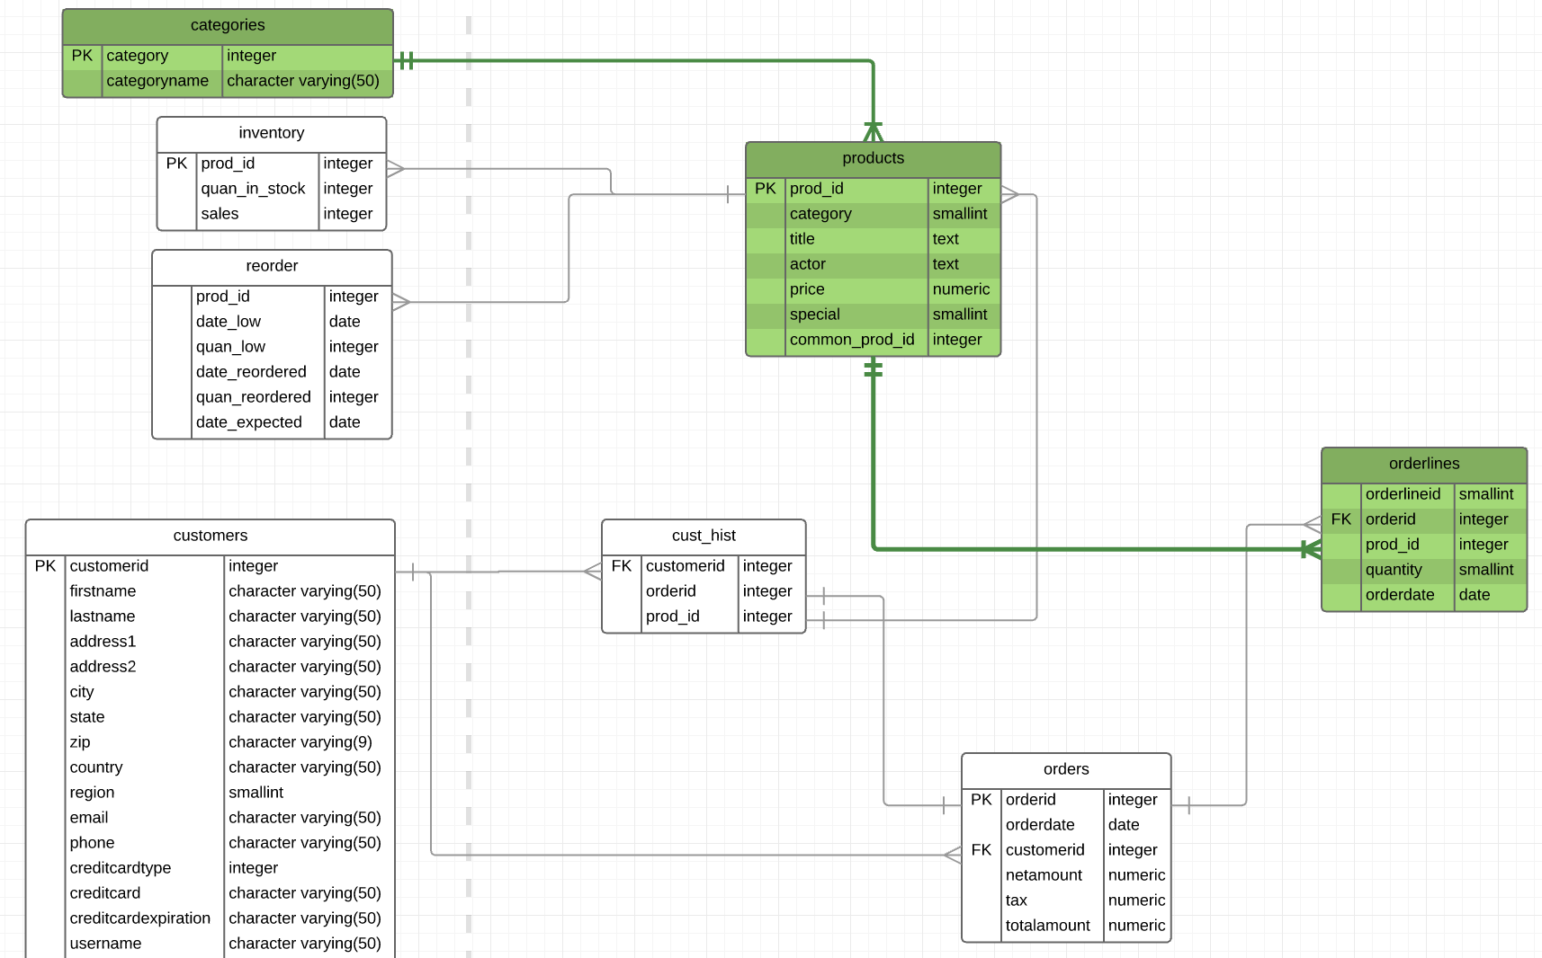
The ERD for the DVD Store
https://www.lucidchart.com/invitations/accept/487d8dfb-fa75-4fe7-b6ed-337ff1018cd1

Slide 13
Explore a data model with Excel

Slide 14
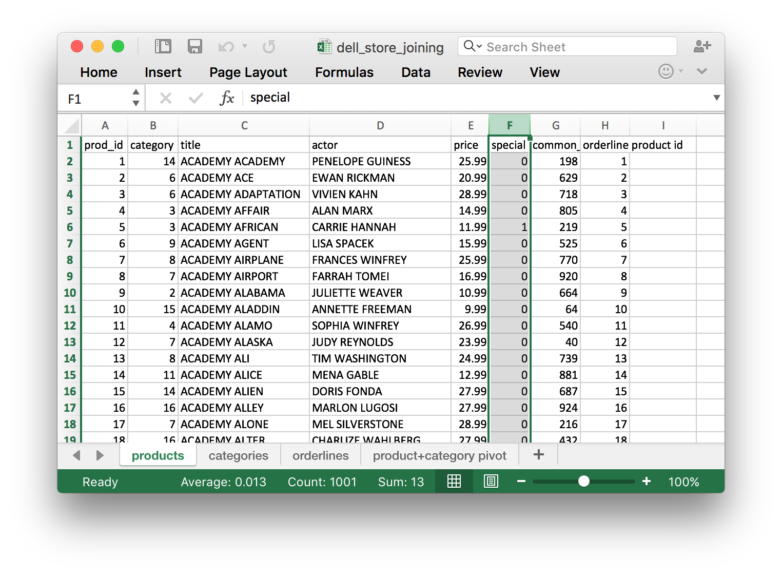
Dell DVD Store in Excel
Count: 1001 (subtract header) = 1000 products
Sum: 13 – there are 13 special products

Slide 15
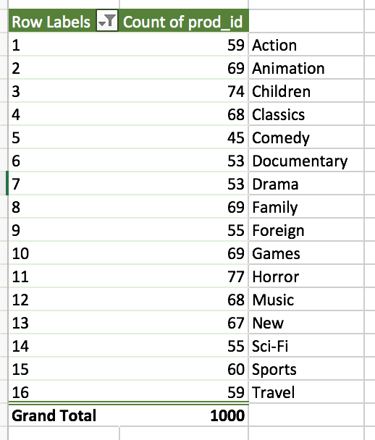
Dell DVD Store in Excel
Pivot products + VLOOKUP of category
16 categories with products
Horror is the most common category

Slide 16
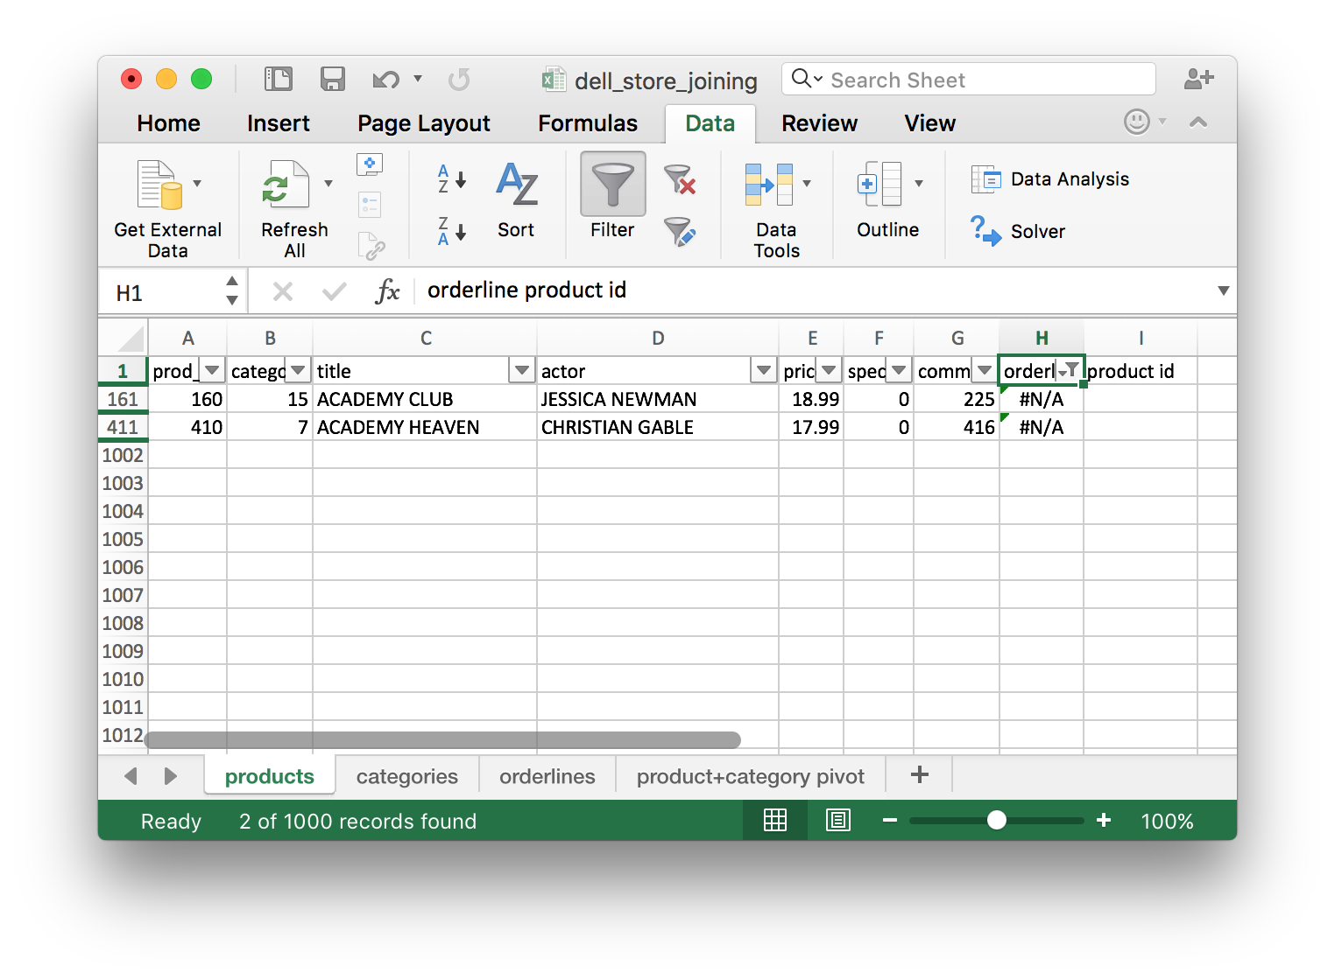
Dell DVD Store in Excel
Products that have never been ordered
Using VLOOKUP of orderlines we see two results
(Also known as “LEFT OUTER JOIN”)

Slide 17
Explore a data model with Tableau

Slide 18
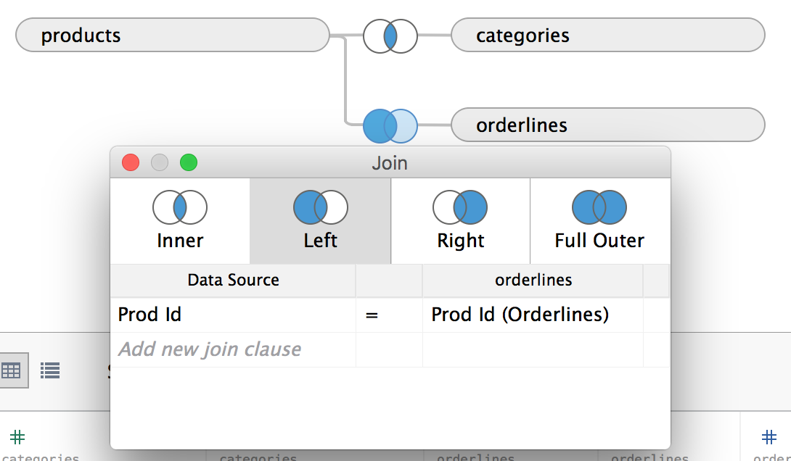
Dell DVD Store in Tableau
INNER JOIN categories to products
LEFT OUTER JOIN orderlines to products

Slide 19
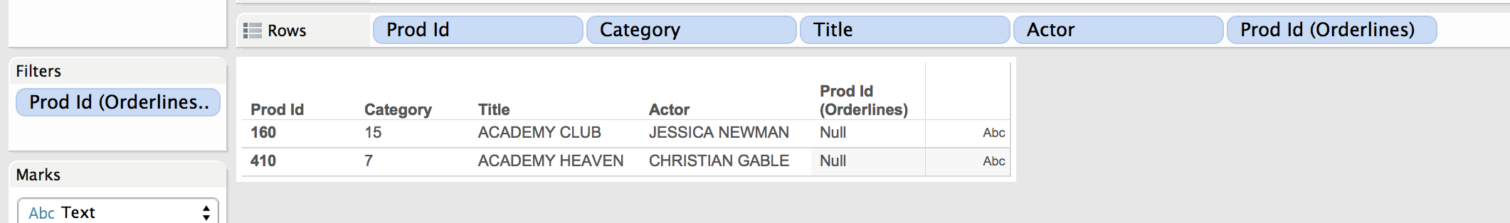
Dell DVD Store in Tableau
INNER JOIN categories to products
LEFT OUTER JOIN orderlines to products

Slide 20
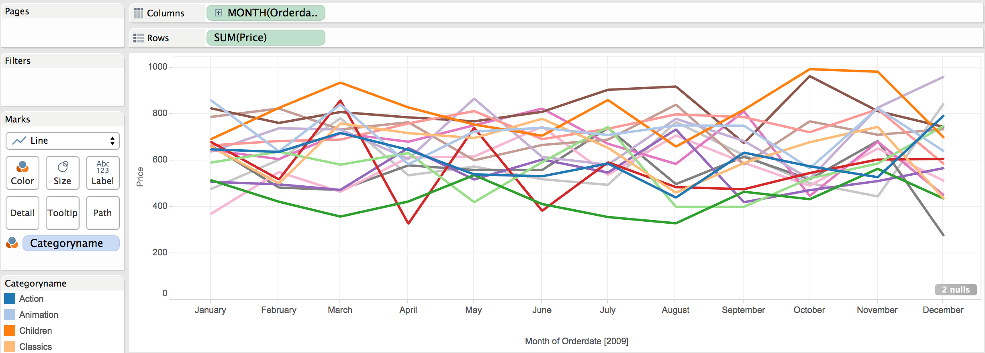
Dell DVD Store in Tableau
INNER JOIN categories to products
LEFT OUTER JOIN orderlines to products

Slide 21
JOIN data with Tableau

Slide 22
FEC Committees
committee
committee_summary
candidate

Slide 23
FEC Committees in Tableau
What committees don’t have a corresponding candidate?
What committees have never gotten a donation?
LEFT OUTER JOIN can help us answer

Slide 24
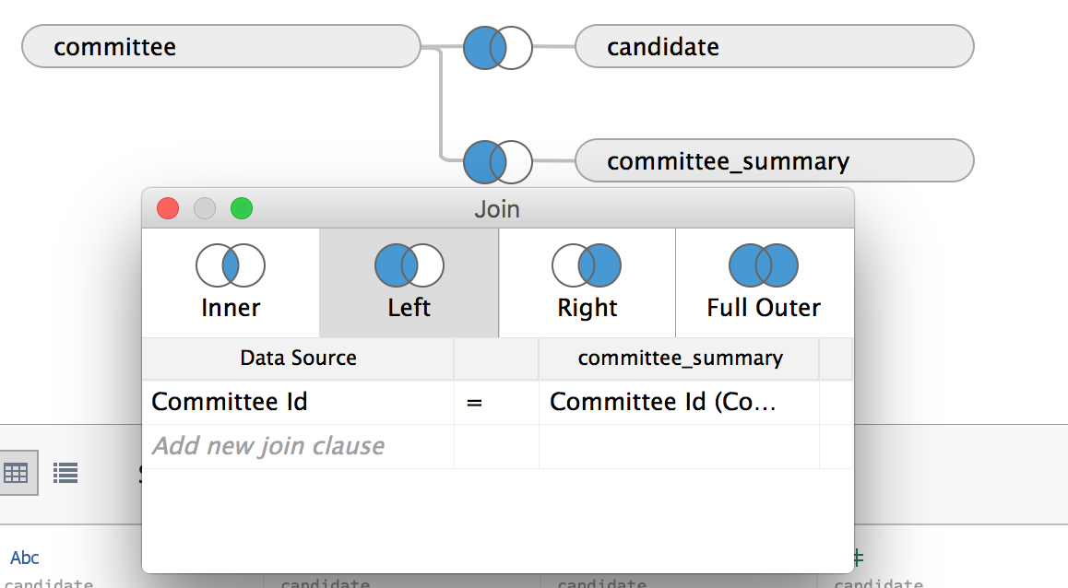
FEC Committees in Tableau
Asdf

Slide 25
Explore a data model with SQL

Slide 26
SELECT
SELECT *
FROM table1
SELECT *
FROM table2

Slide 27
INNER JOIN
SELECT *
FROM table1
INNER JOIN table2
ON table1.join_field = table2.join_field
-- Will pull rows that exist in table1 and table2
-- and have the same value in the join_field
-- The most common join for combining two or tables’ data

Slide 28
LEFT OUTER JOIN
SELECT *
FROM table1
LEFT OUTER JOIN table2
ON table1.join_field = table2.join_field
-- Will pull rows that exist in table1 even if they do not
-- have a corresponding row in table2 for the join_field
-- Gives a comprehensive list of records in table1
-- Watch out if there are many rows in table2 to one row in table1

Slide 29
RIGHT OUTER JOIN
SELECT *
FROM table1
RIGHT OUTER JOIN table2
ON table1.join_field = table2.join_field
-- Will pull rows that exist in table2 even if they do not
-- have a corresponding row in table1 for the join_field

Slide 30
FULL OUTER JOIN
SELECT *
FROM table1
FULL OUTER JOIN table2
ON table1.join_field = table2.join_field
-- Will take all rows from both tables even if they don’t have
-- a corresponding row in the other table
-- Not often used although it can indicates holes in the data.

Slide 31
LEFT OUTER JOIN & not in right
SELECT *
FROM table1
LEFT OUTER JOIN table2
ON table1.join_field = table2.join_field
WHERE table2.join_field IS NULL
-- Will take all rows from table1 that don’t have a corresponding
-- row in table2 matching the join_field
-- Good for finding holes in data

Slide 32
UNION
SELECT *
FROM table1
UNION
SELECT *
FROM table2
-- table1 and table2 must have
-- the same columns, or the same
-- columns selected in the queries
-- good for creating Tableau-friendly
-- ”tables” of data
+

Slide 33
Spatial data modeling

Slide 34
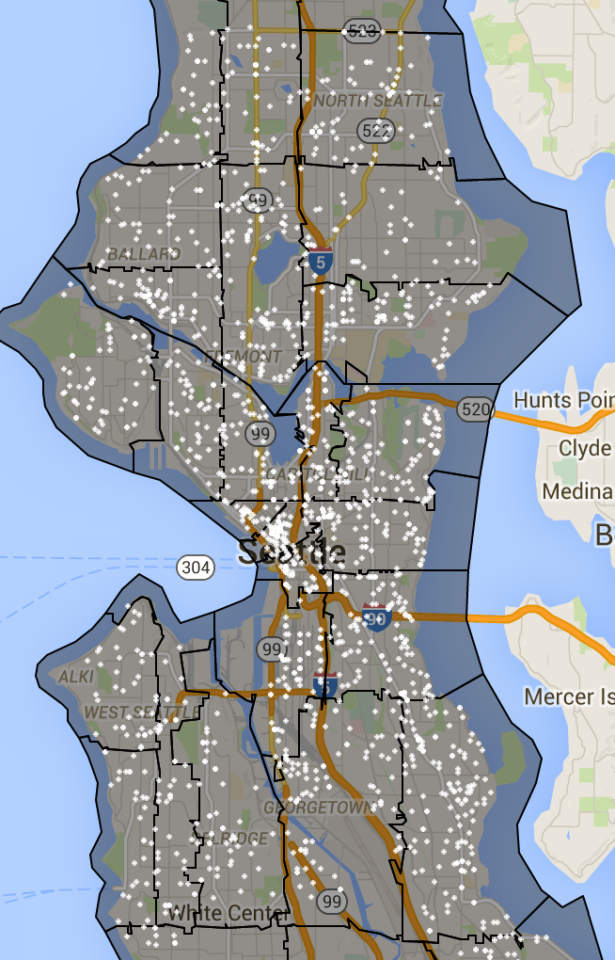
”Join” Crimes to Zip Codes
A look at assigning crimes to Zip codes
http://vizz.site/zips-and-crime.html

Slide 35
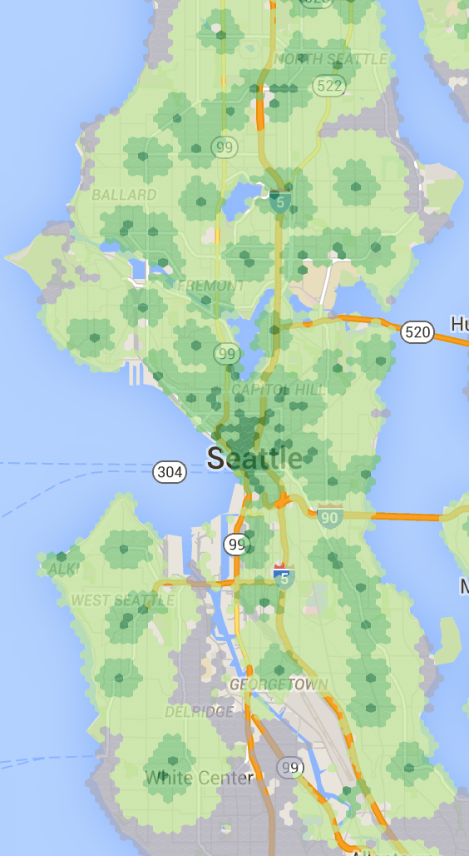
Distance from Starbucks in Seattle
Distance to a Starbucks in Seattle area
http://vizz.site/starbucks-dist.html
And then I found this:
http://www.safer-america.com/firearmsandfraps/

Slide 36
Homework
If you have Tableau Pro, or some way to connect to a database, connect to a PostgreSQL database and visualize anything.
If you don’t have the ability to connect to a PostgreSQL database
Optional reading:
Now You See It, Stephen Few, 2009
Chapter 1: Information visualization
Chapter 2: Prerequisites for enlightening analysis
Chapter 3: Thinking with out eyes

